Slide 1


SAP UI5 & FIORI with OData TRAINING using BAS
Anubhav Oberoy
Day – 6

Slide 2

Agenda – Day 6
Introduction to Component.js File
Creating our first fiori like app
Understanding the App Container
Working with multiple views
Navigation between the views
Introduction to Manifest.json file
Section of manifest.json
Introduction to List controls in SAP UI5
Types of List in UI5
Creating model in Manifest.json
Search Functionality
List Modes and Grouping
Header and Footer Toolbar
Worklist Application
Split App Container

Slide 3
Component.js File
Component.js the starting point of all Fiori applications, it is used by Fiori Launchpad to kick-start our app. If an app has Component.js inside, it called Fiori like app.
We will decouple everything from index.html to avoid user starring app w/o launchpad because of security rick of user opening app direct from index file.
It is the wrapper of all the functionality.
The name of the file must be, must be Component.js
It should ideally be created inside the webapp folder
If our app does not have Component.js, we will not be able to integrate our app with launchpad
It is a class which inherits from sap/ui/core/UIComponent standard class. We inherit to reuse the functionality offered by SAP like routing.
When app starts, UI5 framework will scan your project’s base directory to check if it has a file with exact name Component.js
The component file calls the manifest file, and we keep all app level configuration inside the manifest file.

Slide 4
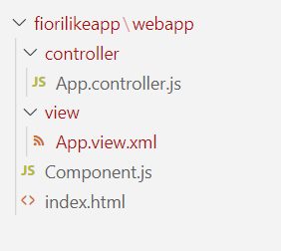
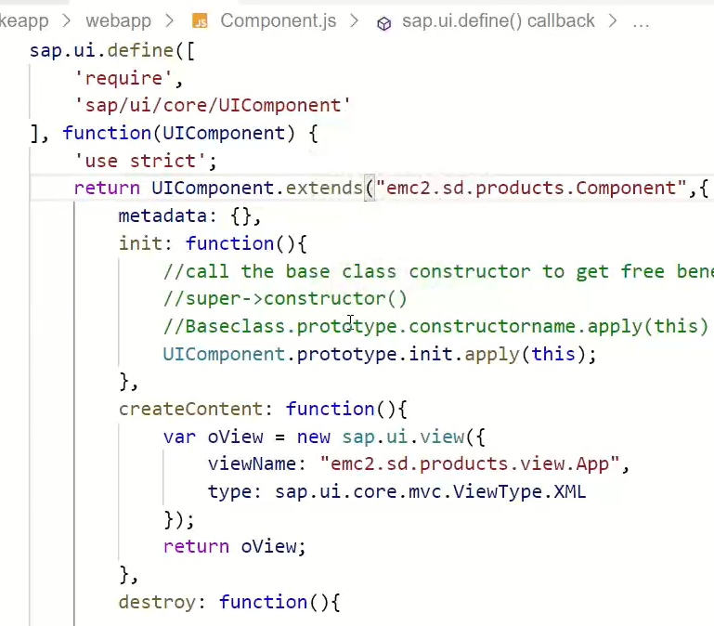
Hands – on: Create our first Fiori Like app
Create a new folder named fiorilikeapp in our projects directory, using the command mkdir fiorilikeapp.
Now navigate to the newly created folder using the command cd fiorilikeapp, and then create a webapp folder inside this newly created folder using the command mkdir webapp. Then move inside this folder using command cd webapp.
Now create two files in the webapp folder using the commands touch index.html and touch Component.js
After this create a App view and App controller in the respective view folder and controller folder.
Once the files are created paste the code from below links.
Code links:
index.html
Component.js
App.view.xml
App.controller.js
Namespace naming convention: “company.area.project”
Example:
ibm.fin.ar
emc2.fin.ar
ibm.hr.payroll
ibm.fin.ap

Slide 5
Plane
W,h,color,fuel
Passenger plane
Passenger
SUPER->constructor()

Slide 6
Structure of a Fiori App
There are different folders and directory are required for setup project: webapp, Controller, models, utils ,view, Component.js, manifest.json, index.html
Structure of normal ui5 application
Index.html
View
Controller
Structure of Fiori Application
Dev.
sap/ui/core/UIComponent
Index.html
Root View
App.view.xml
Component.js
View 1
Controller 1
Container
App (pages)
View 2
Controller 2
manifest.json
App descriptor
App.controller.js
BaseController
Component.js is starting point

Slide 7
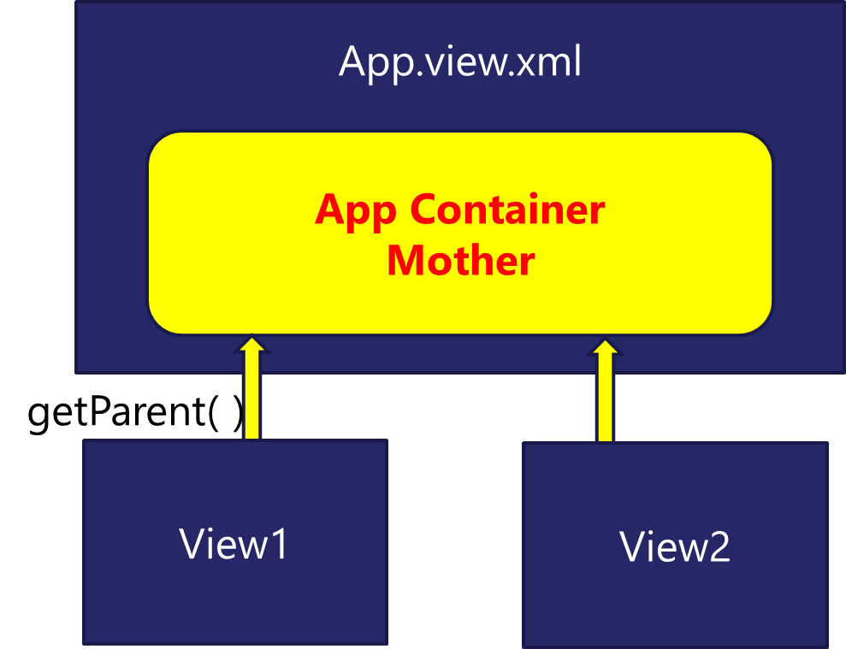







App Container
Most of the Fiori app developed in the industry used to have more than one view. To work with multiple views, we use the concept of Parent View in the Fiori application. Which means all the views are loaded in one Parent View(App View) which then calls the view we want to display to the user.
The App view will behave as a container for other views.

Slide 8
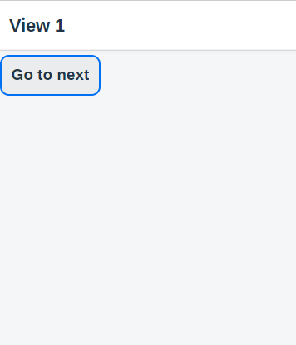
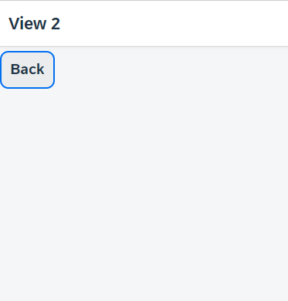
Hands – on: Working with multiple views
Now to understand how the app container works we will add two new views (View1 and View2).
Similarly we have to create a View1 controller and View2 controller.
Since we are using multiple controllers we should also create a Base Controller to inherit the controller class at one place.
Once these files are created, copy the code from below links.
For this exercise we will create a Button on both View1 and View2. On press of that buttons we will navigate to the another view. View1 to View2 and vice-versa.
Code Links:
App.view.xml
App.controller.js
View1.view.xml
View1.controller.js
View2.view.xml
View2.controller.js
BaseController.js
Component.js

Slide 9
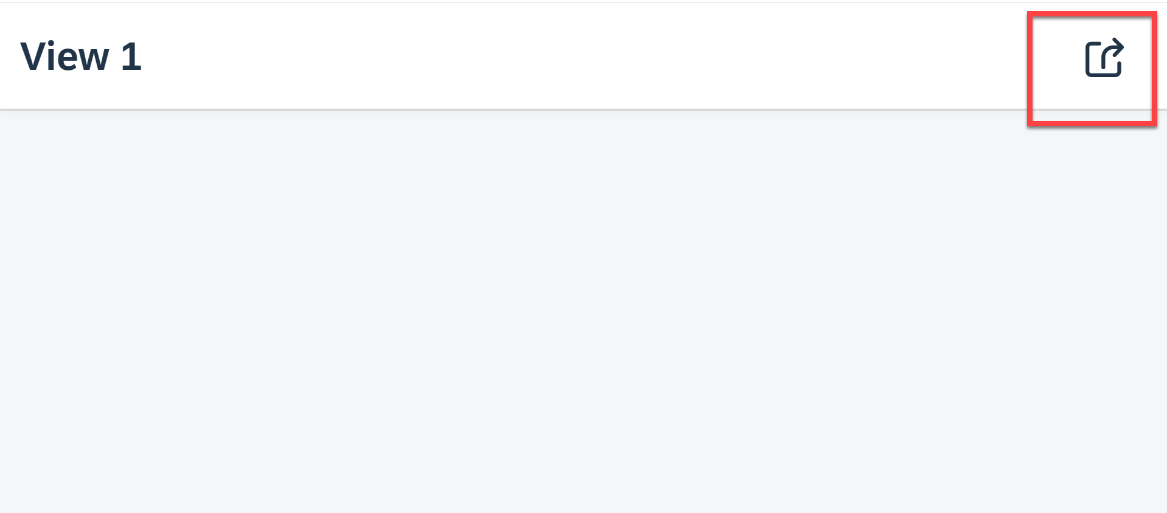
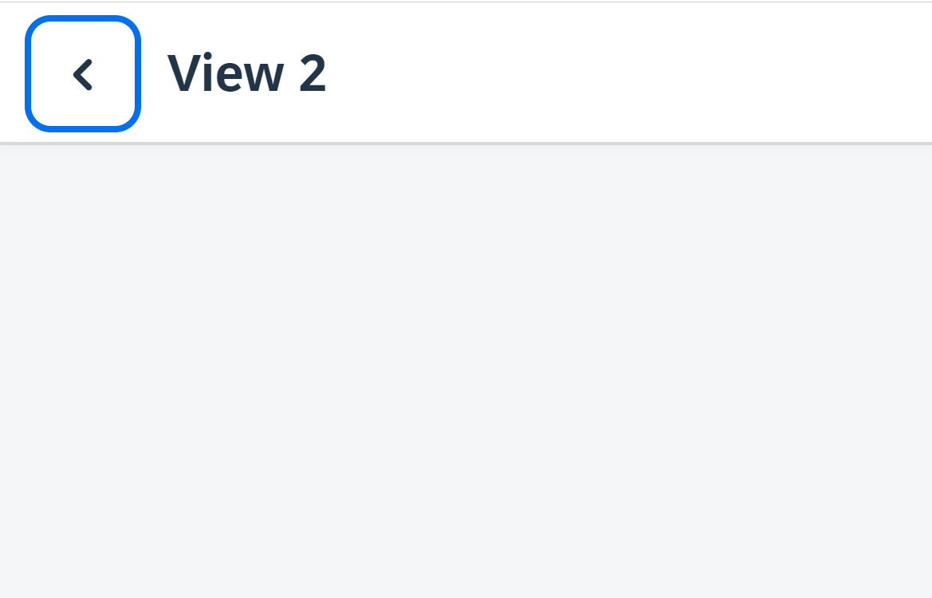
Hands – on: Header Navigation Buttons
As we see in most of the application the Navigation button are place inside the navigation bar at the top.
So we, will move the button to the Nav bar using the headerContent aggregation of the sap.m.Page control.
The standard page control also provides a some properties to add the Nav button without using the custom control.
Code Links:
View1.view.xml
View2.view.xml

Slide 10
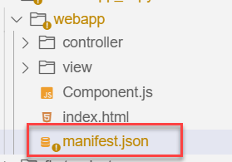
Manifest.json file
manifest.json is also knows as application descriptor file. When someone look at my application, my application descriptor will express all the necessary properties.
It contains all the configuration for our application.
manifest.json is a file which contains all the properties and initialization of our app. When app starts SAPUI5 framework will read this file and generate necessary artefacts out-of-box for us.
It is written in JavaScript Object Notation (JSON) format.
Reasons why we need manifest:
Once upon a time, I was in goa and enjoying my drink on beach, suddenly my phone rings and guess who is on the other side? You have developed a Fiori app last week and left for vacation, today we have a customer ticket and I am sitting with one your colleague, unable to understand what you did? Can you come and connect for some time.
A team member is leaving our team, he/she has developed 20 Fiori apps and now you suppose to take handover, she/he is not cooperating because they leaving, how will you hold on to the code?
SAP Delivers 1000s Fiori apps but they don’t send mobile no. of Labs developer. How will we understand where and what app is doing?
Documentation for manifest.json file: https://sapui5.hana.ondemand.com/#/topic/be0cf40f61184b358b5faedaec98b2da

Slide 11
Section of manifest.json
sap.app contains id, type, i18n, applicationVersion, title, description, dataSources.
sap.app
sap.ui contains technology, icons, deviceTypes, supportedThemes
sap.ui
sap.ui5 contains different components
rootView, dependencies, contentDensities, models, routing etc.
sap.ui5

Slide 12
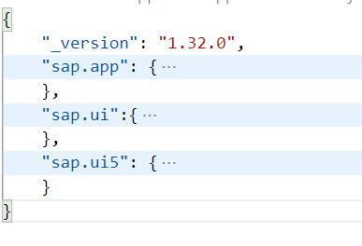
Hands – on: Create the manifest.json file
Now we will create the manifest.json file in our webapp folder.
Along with that we have to create the i18n folder and in that folder a i18n.properties file.
Then we have to add the required code to these file.
Also link the manifest to the Component.js file.
Code Links:
manifest.json
i18n.properties
Component.js

Slide 14
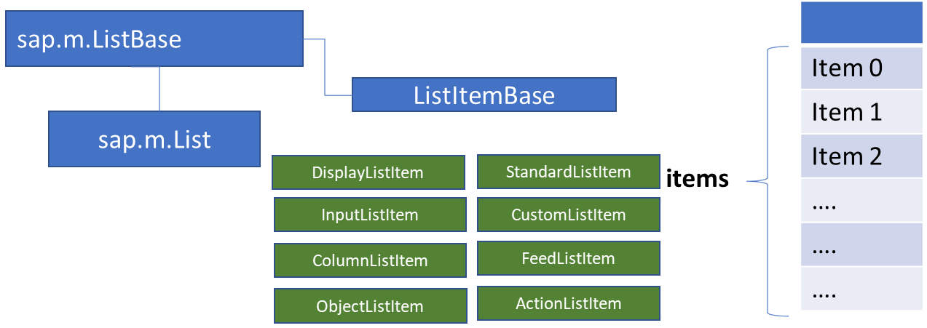
List Control
The list contains various list items. These items can be of various types depending on the use case and on the content they have. SAPUI5 already provides the most common list items in SAP Fiori in the form of controls, although custom list items can also be created if necessary.
Reference: https://sapui5.hana.ondemand.com/#/entity/sap.m.List
A List control is a single column table with multiple items inside. We will have a list header and items as aggregation.

Slide 15
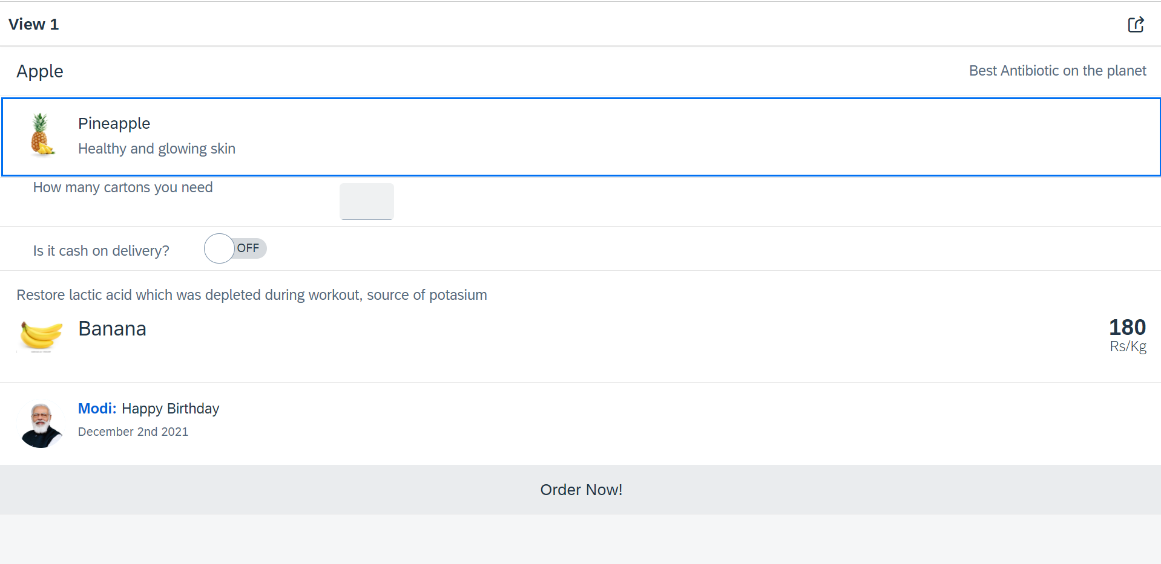
Hands – on: List Controls in UI5
Now we will add some basics list controls in the View1 of our application.
Code Links:
View1.view.xml

Slide 16
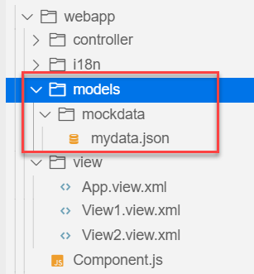
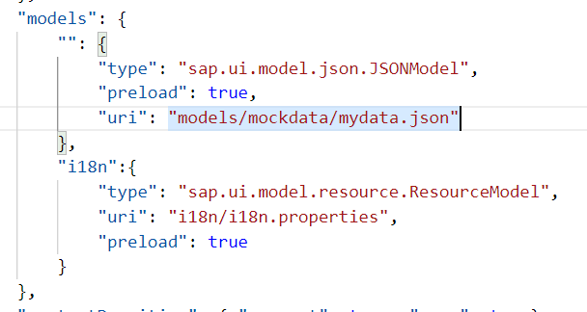
Hands – on: Models in manifest.json
Now we want to bind our list control to a model to show the multiple records using the list control.
For this first we need a file with some demo data related to the fruits, so we have created a file which has three entity sets:
fruits – name, color, type (neutral, citrus, alkaline),price, healthBenefit, unit, status (available, discontinued, out of stock), image (url from google) – 20
cities – name, state, famousFor, population – 10
supplier – name, city, country, contactPerson, phone, email, sinceWhen – 10
Now we will create a models folder in the webapp and in the models folder we will create a folder named mockdata, we will put our json file in this folder.
Code Link:
manifest.json
mydata.json
View1.view.xml

Slide 17
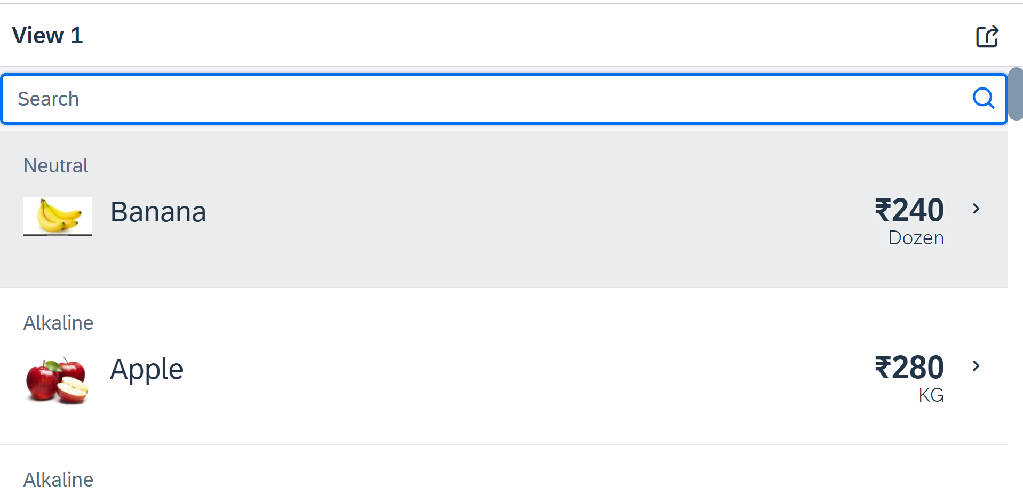
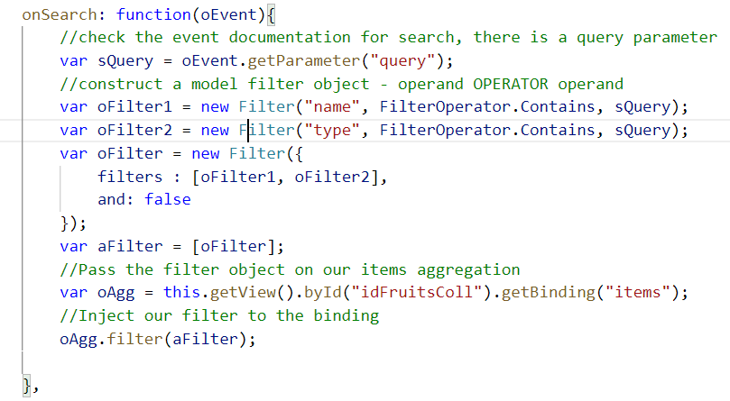
Hands – on: Search Functionality
Nowadays we come across many web pages that provide data in the form of lists or tables. These lists are enabled with search functionality, i.e., as the user types in into the search field and press enter then the data in the list is filtered according to the value in search field.
Code Link:
View1.view.xml
View1.controller.js

Slide 18
List Modes
The mode property defines the appearance of the left area of a list item.
Lists have properties and events and they contain list items that inherit from sap.m.ListItemBase, which provides navigation, selection and event features.
Delete
SingleSelect
01
04
only one list item can be deleted via provided delete button
Right-positioned single selection mode (only one list item can be selected).
01
04
MultiSelect
You can edit this text
SingleSelectLeft
02
05
02
more than one list item can be selected
05
Left-positioned single selection mode (only one list item can be selected).
03
06
None
03
06
SingleSelectMaster
no selection
Selected item is highlighted but no selection control is visible (only one list item can be selected).

Slide 19
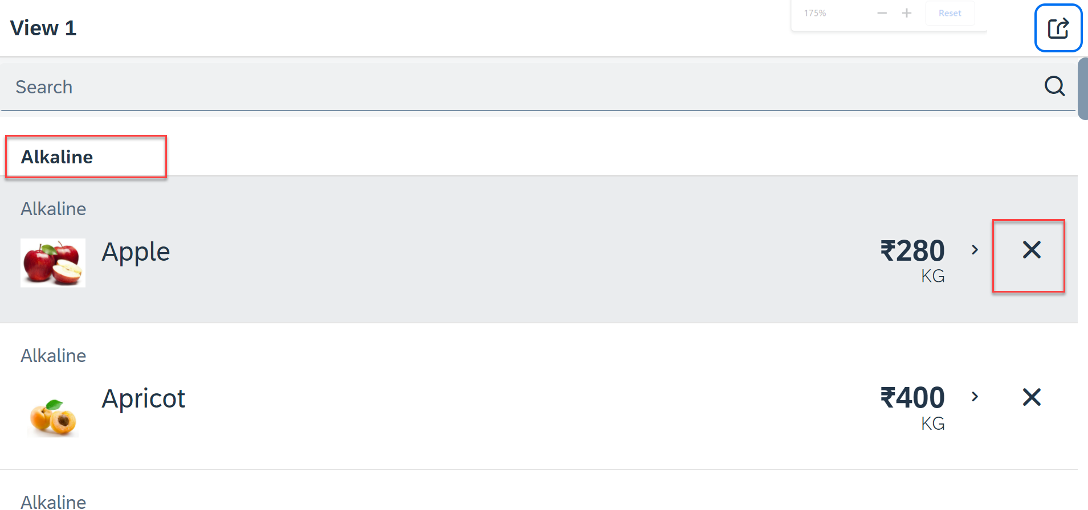
Hands – on: List modes and Grouping
Now we will look at the different type of List mode provided by the UI5.
Along with that we will Implement the Press event, Selection change and Delete Event in the List Control.
Also we will Group the data according to the type of Fruit.
Code Link:
View1.view.xml
View1.controller.js

Slide 20
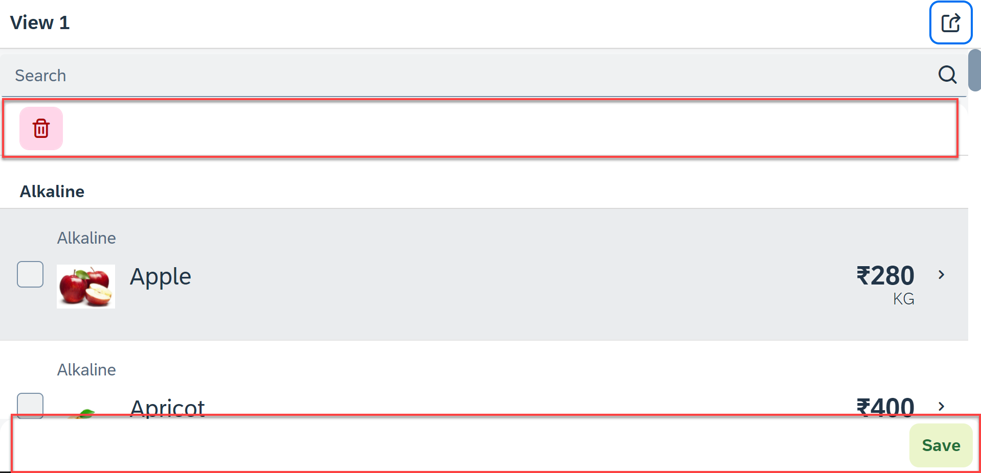
Hands – on: Header and Footer Toolbar
Now we will add a Header Toolbar to the list control and in that we will add a delete button to delete multiple items from the List.
We will also add a Footer toolbar to the page control and in that we will add a save button on press of the save button a alert will be shown to the user.
Code Link:
View1.view.xml
View1.controller.js

Slide 21
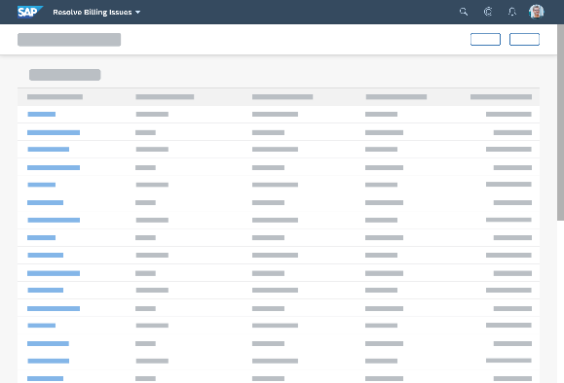
Introduction to Worklist Application
A worklist displays a collection of items a user needs to process. Working through the list usually involves reviewing details of the items and taking action. In most cases, the user has to either complete a work item or delegate it.
When to use:
Users have numerous work items and need to decide which ones to process first.
You want to give users a direct entry point for taking action on work items.
Users need to work with multiple views of the same content (for example, items that are “Open”, “In Process”, or “Completed”). You want to offer tabs for switching between views.
Detail View
List Page

Slide 22
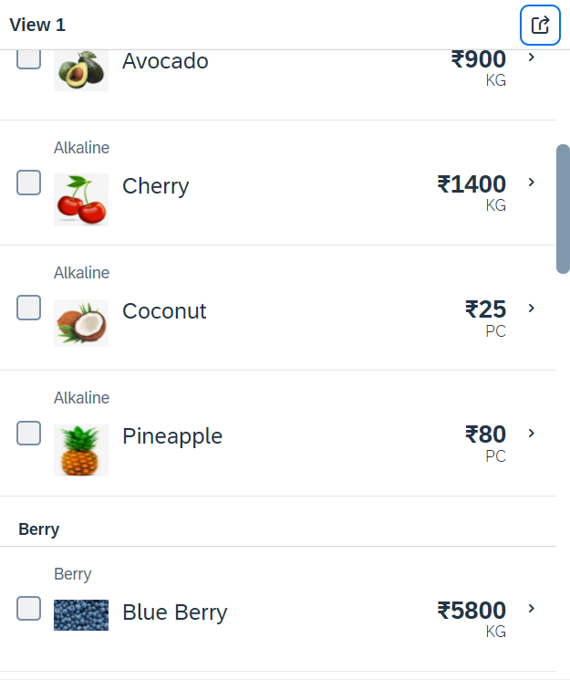
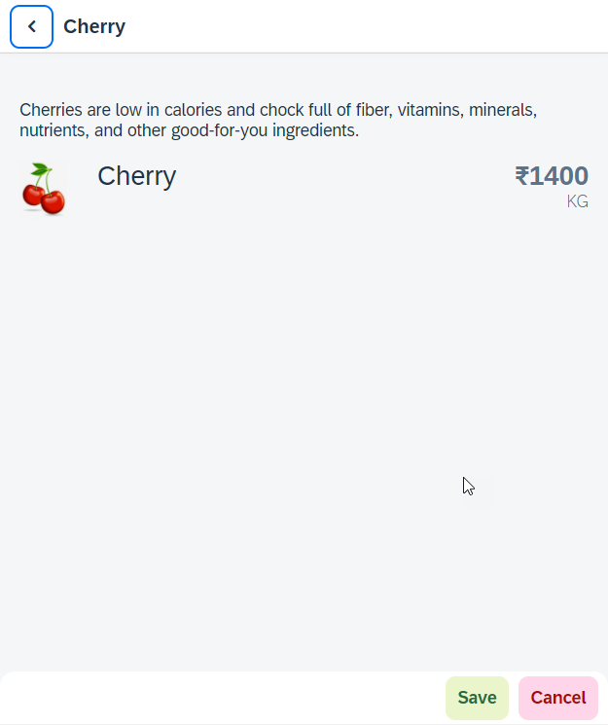
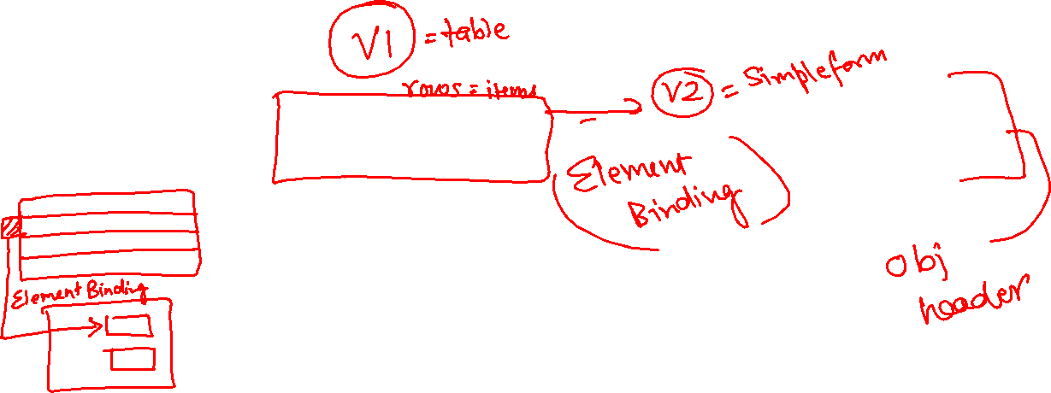
Hands – on: Worklist App
Now we will make our application a worklist app. On selecting the fruit on the View1 navigate to the View2 and show the details of that the selected fruit on it.
For this we have to modify the onSelectItem Function to get the path of the selected item and pass it in the onNext function.
Code Link:
View1.view.xml
View1.controller.js
View2.view.xml

Slide 23
SplitApp Container Control
A split app container control will divide our app into 2 parts, 1st is called master section and 2nd is called detail section. It is used to fully optimize the screen width for desktop apps.
SplitApp Container
masterPages
detailPages
App Container
View1
View2
View1
View2

Slide 24
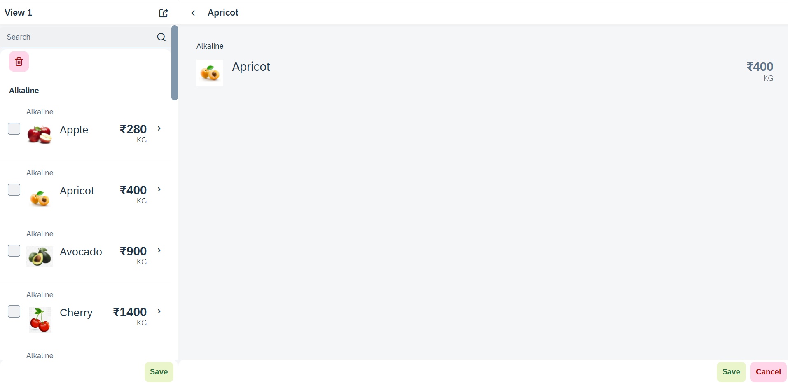
Hands – on: SplitApp (Mater Detail App)
Now we will convert our worklist app to a master detail application.
Once we change the app container, we have to change the method of getting the view object in onNext function.
Code Links:
App.view.xml
Component.js
View1.controller.js

Slide 25

End of Day 6

Slide 26

Questions

Slide 27

Anubhav Oberoy

Slide 28


We’re committed to empower you to be
Most Desirable Resource
through powerful training solutions.
We build the workforce of the future.
250+
Corporate Clients
30,000+
Learners Trained
25000+
Learners Placed
FREE WEBINARS
Sign up for free webinars with industry experts every fortnight!
Enroll Now!
Contact us today!
https://anubhavtrainings.com/

Slide 29




More from AnubhavTrainings.com

Slide 30
Title
Content

